Slide 1

Sprocket Central Pty Ltd
Data analytics approach
KPMG Lighthouse and division Team
Tony Smith, Senior Consultant
Kritika Garg, Junior consultant

Slide 2
Agenda
Introduction
Data Exploration
Model Development
Interpretation
Future steps

Slide 3
Introduction
Optimize resource allocation for targeted marketing
Study the distribution of customers by age, gender, geographically, etc.
Identify the product category areas with maximum customer base and corresponding profit.
Identify the customer category and areas that drive the market mostly
Identify the customer category and areas with low purchases.
Allocate more resources and products towards high-demand customers
Advertise and diversify products to attract low-demand customers and convert them to high-value

Slide 4
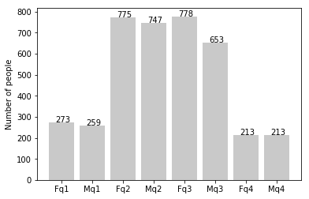
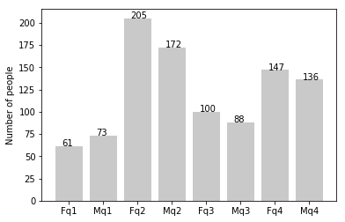
Data Exploration
Distribution of customers by age and gender
New customers are mostly between 25 to 48 years old.
Number of customers from 48 to 59 years old have big drops on percentages.
There is a slight increase in the number of customers over 59 years old in term of percentages
The percentages of under 25 years old did not change much.
Old customers
New customers

Slide 5
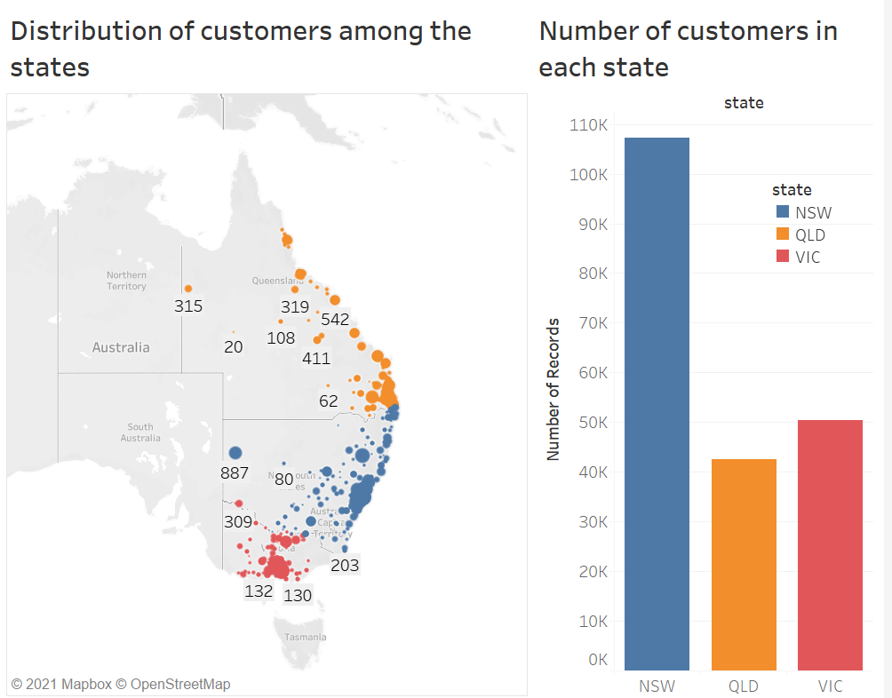
Data Exploration
Geographical distribution of customers
New South Wales hosts the maximum amount of customers
The difference is quite large than Queensland and Victoria
This observation can help locate the resources geographically according to the customer’s demand.

Slide 6
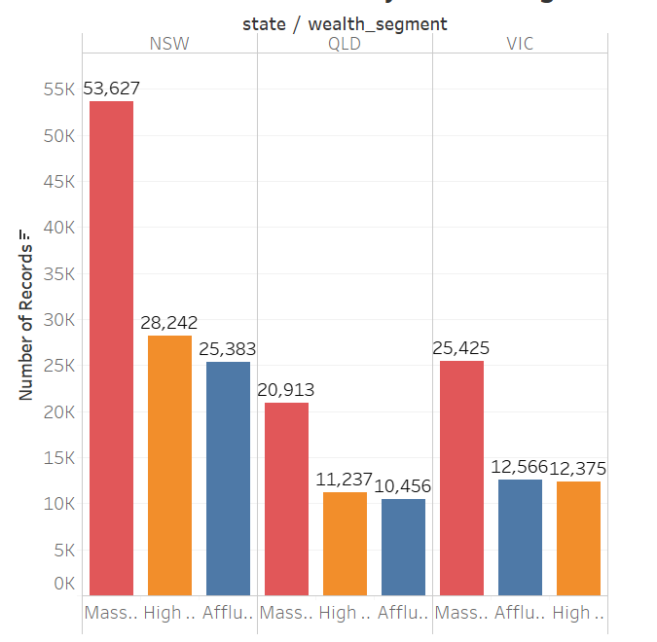
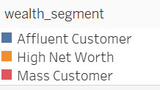
Data Exploration
Distribution of customers by wealth segment in each state
The number of all type of customers: Affluent, High Net worth and mass are high in NSW.
Thus, for each customer category NSW must be made the hub for the demanded product lines and brands
Causes for lower number in other states must be identified.

Slide 7
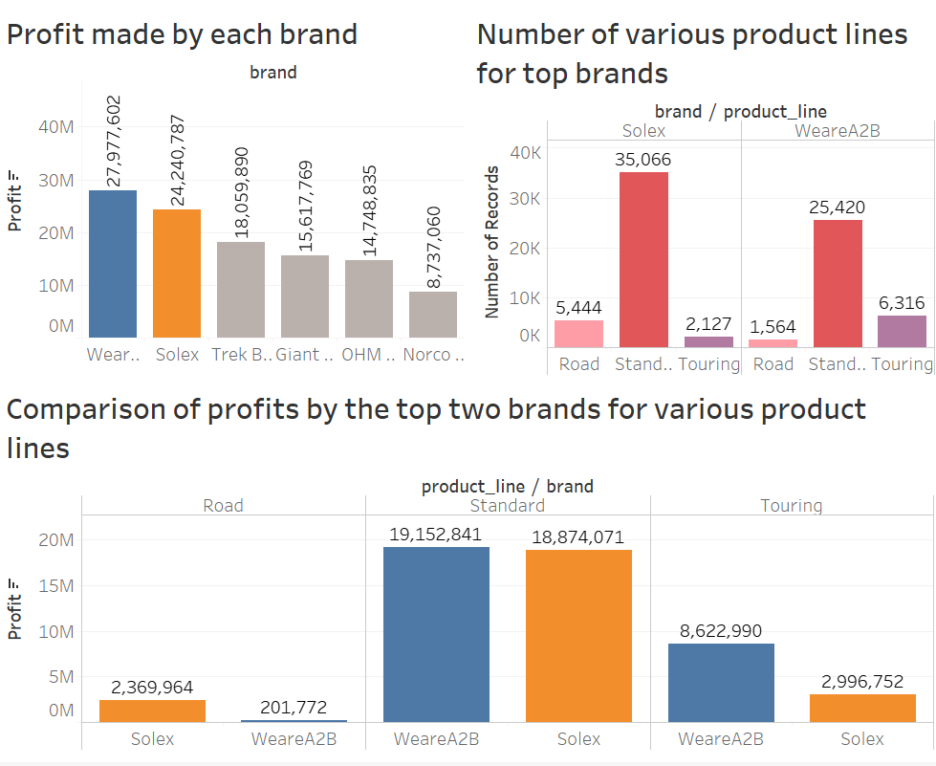
Model Development
Hypothesis: Does brand name influence the profit margin for the same product line?
WeareA2B has the highest profit followed by Solex.
Both these brands have maximum sale in standard product line.
Although the number of standard products sold by each brand differs widely, the corresponding profits are almost similar.
However, for other product lines, profit corresponds to the number of sales.

Slide 8
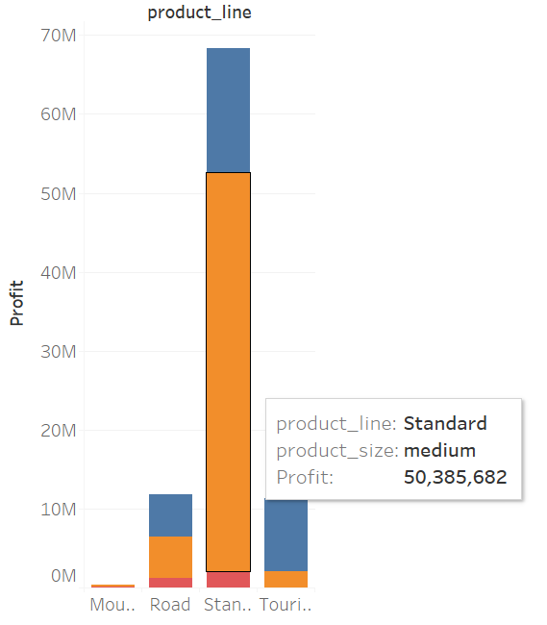
Interpretation
Strategies proposed:
Identify the key factors influencing profit in each product line.
Study the correlation between brand and profit statistically using regression models.
Evaluate if the wealth segment of the customer or their geographical location affect this correlation.
Confirm if medium-sized standard products provide the maximum profit in most customer-settings.

Slide 9
Future steps
Build a prediction model for targeting new customers:
Based on the hypothesis, build a prediction model to predict resource allocation for new customers in order to maximize profits, retain existing customers and attract new potential customers.

